Slide 1

Recommendation Systems
Mini Project: Movie Recommendation System

Slide 2
Data Preprocessing and Exploration
3 Files in the format -
"ratings.dat"
Format: UserID::MovieID::Rating::Timestamp
"users.dat"
Format: UserID::Gender::Age::Occupation::Zip-code
"movies.dat"
Format: MovieID::Title::Genres
All files were converted to .csv

Slide 3
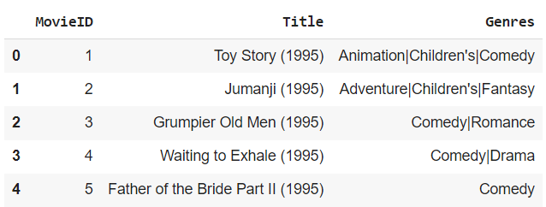
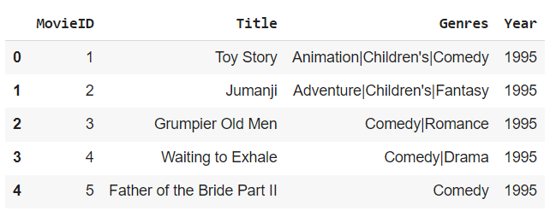
Separated Year from Title and made a separate column

Slide 4
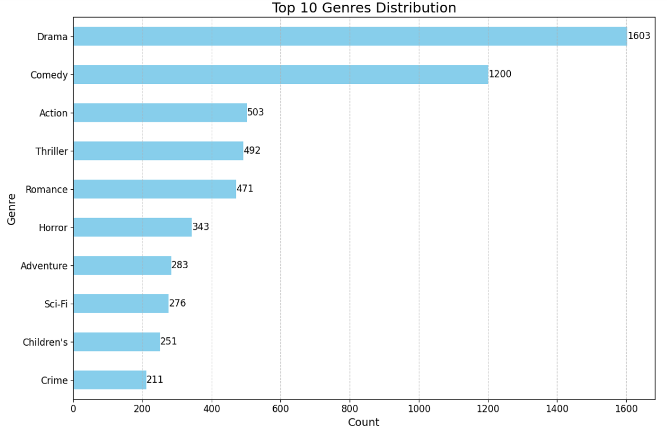
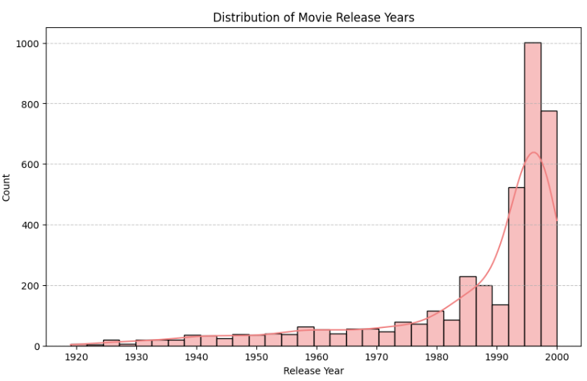
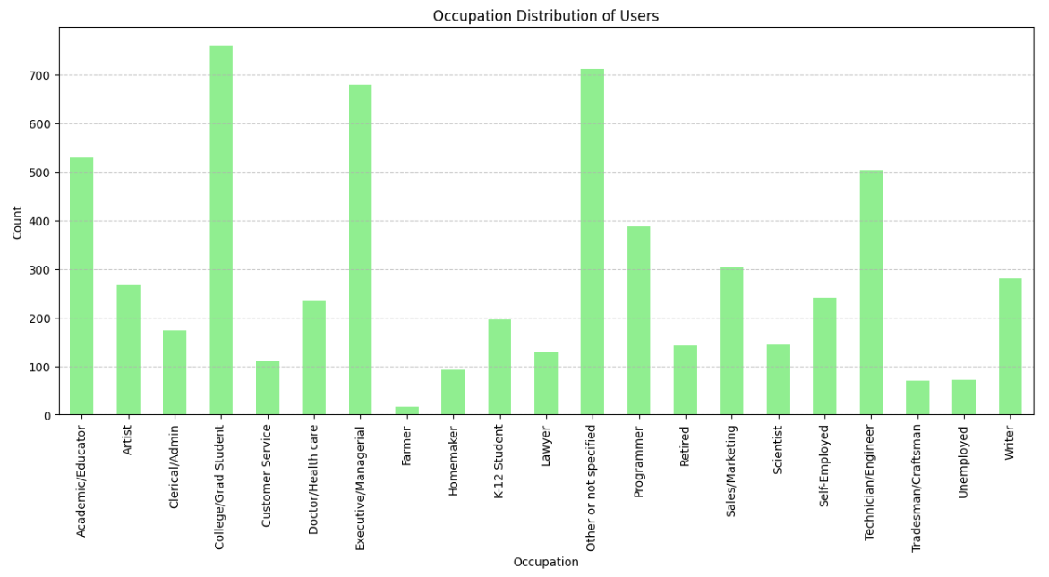
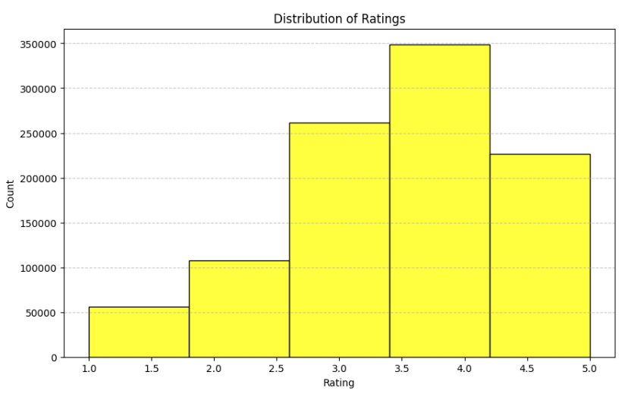

Slide 5
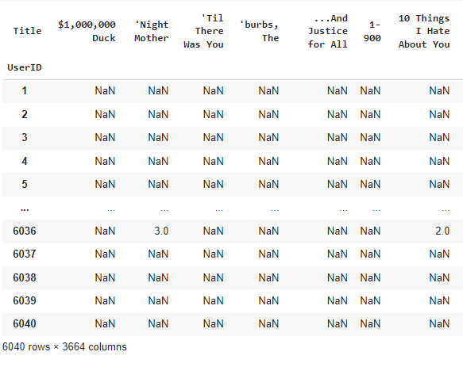
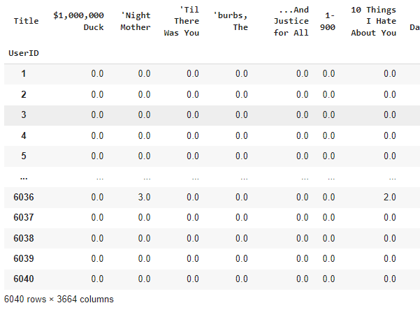
Prepared User-Movies Matrix
Combined all tables and made a User-Movies Table of size 6040x3664
Rows - Users and Columns - Movie titles
NaN entries were filled with 0

Slide 6
Collaborative Filtering
User-User based
Calculated the bias of the new user
Appended new user’s rating to the User-Movie matrix
Found similar users to the new user using Cosine Similarity
Aggregated all ratings of similar users while removing the bias of each user
Computed the predicted ratings for this new user and recommended the top 5 movies.

Slide 7
Reduced SVD and K-Means
Matrix size is too big for directly applying cosine similarity
Used SVD to find latent features for better representation
Used K-Means for clustering similar users

Slide 8
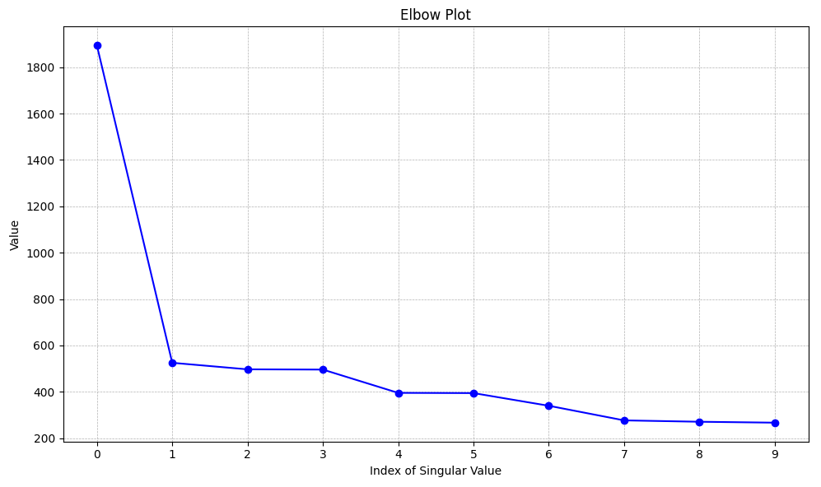
SVD -
Decomposed Rating matrix into U S Vt matrices
Chose sigma - 5
Too less - Loss of information
Too high - Noise

Slide 9
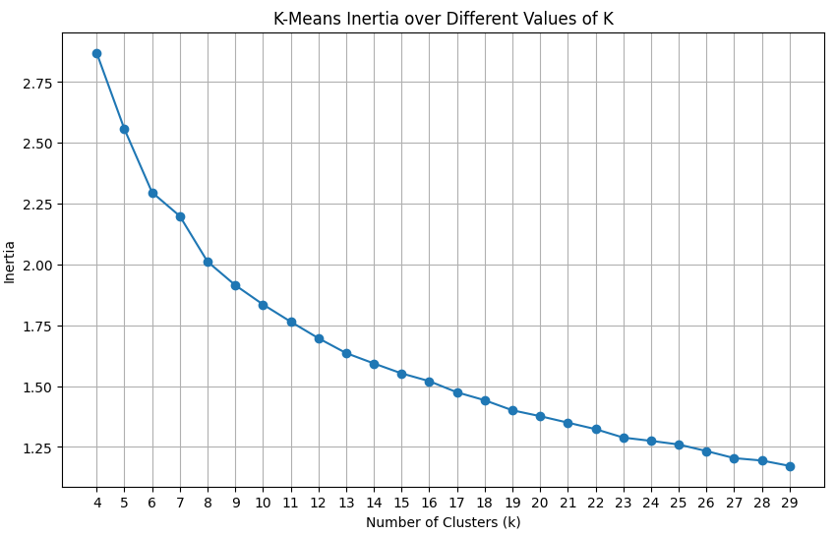
K- Means -
Clustered similar users for ease of computation
Number of clusters selected - 12

Slide 10
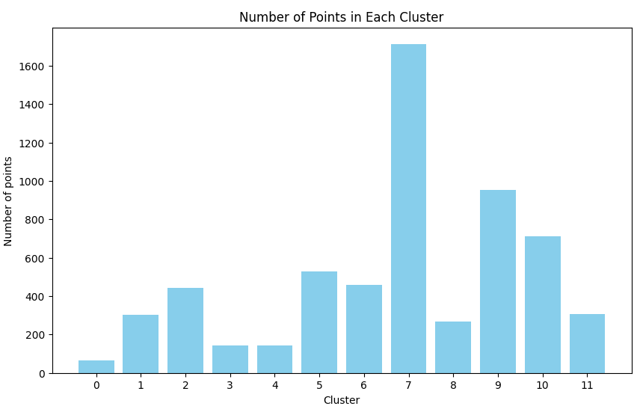
Distribution of users per clusters
A high peak might have been caused by high number of users rating drama and comedy

Slide 11
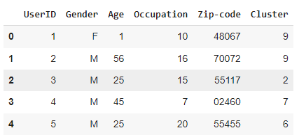
Appended cluster number within Users table so can be used later
Build Recommendation System

Slide 12
Accuracy Criteria -
Picked 500 random users from the Ratings table
For each user
Found rated movies
Split into 2 parts
Used one to get predictions
Compared predictions with other half

Slide 13

Results -
Accuracy within 1 point allows error of 1 rating
Eg - Allows 2, 3, 4 ratings if actual rating is 3

Slide 14
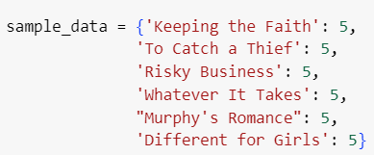
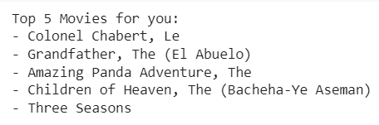
Prediction for new user-
When new user comes, find it’s complete rating vector by filling 0’s in non rated movies
Convert to latent space
Find cluster
Calculate predicted ratings
Recommend top 5 movies

Slide 15
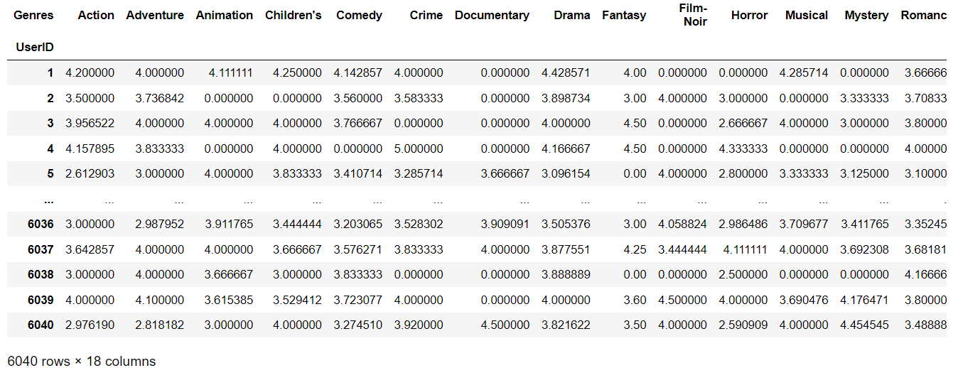
Genre Based predictions-
Using Genre based matrix as well

